Slide 1
Typescript

Slide 2
Agenda
TypeScript
Pros/Cons
Compiler
Running Typescript – Concurrently mode
TS-node
Modules & Types
Casting

Slide 3
Agenda
Types & interfaces
Core & Custom
Aliases
Extending interfacing
Nested Objects
Touples
Enum
Union
Unknown , any , never
External resource type
Json
Partials

Slide 4
Agenda
Functions and Classes
Intersections
Function Types
Classes modifiers
ReadOnly
Abstract
Function overload
Advanced
Guards
Index properties
Type casting
Union advanced
Conditional types

Slide 5
Agenda
Generics
Generic function
Constants
Keyof
Generic utilities
Generic vs Union
Decorators – if time permits
Why using decorators?
Class decorator
Decorator factories
Property decorator
Accessor
Validators

Slide 6
TypeScript
“TypeScript is a strongly typed programming language that builds on JavaScript, giving you better tooling at any scale.”

Slide 7
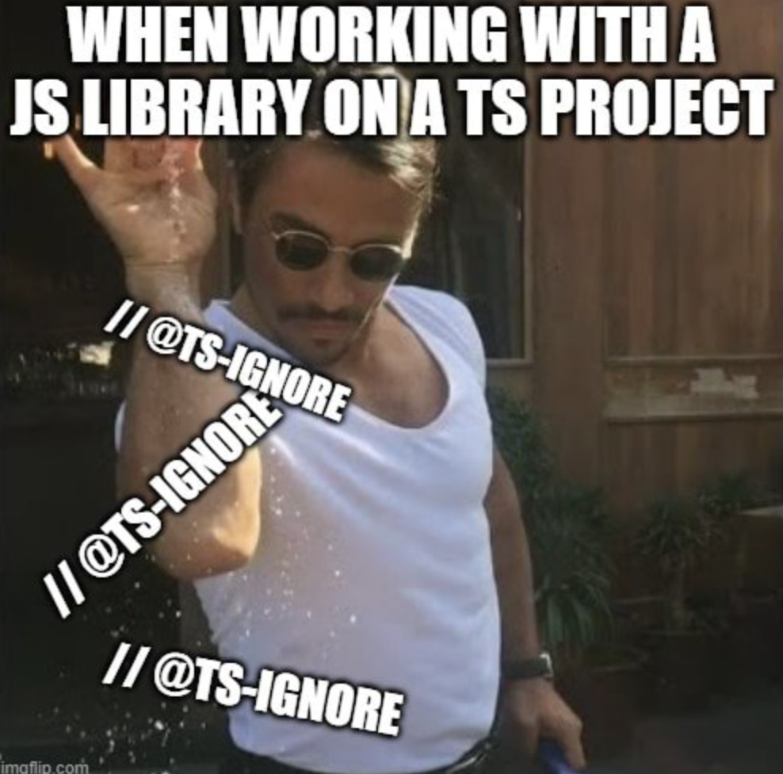
TypeScript Why NOT ?

Slide 8
Overhead…
Additional code
Takes more time
Increase the code ( lines terms )
Short & Simple code

Slide 9

“Solve problem that I don’t have”

Slide 10

Ment to be Dynamic or Jungle..
JavaScript strange behaviors
{}+[] ?

Slide 11
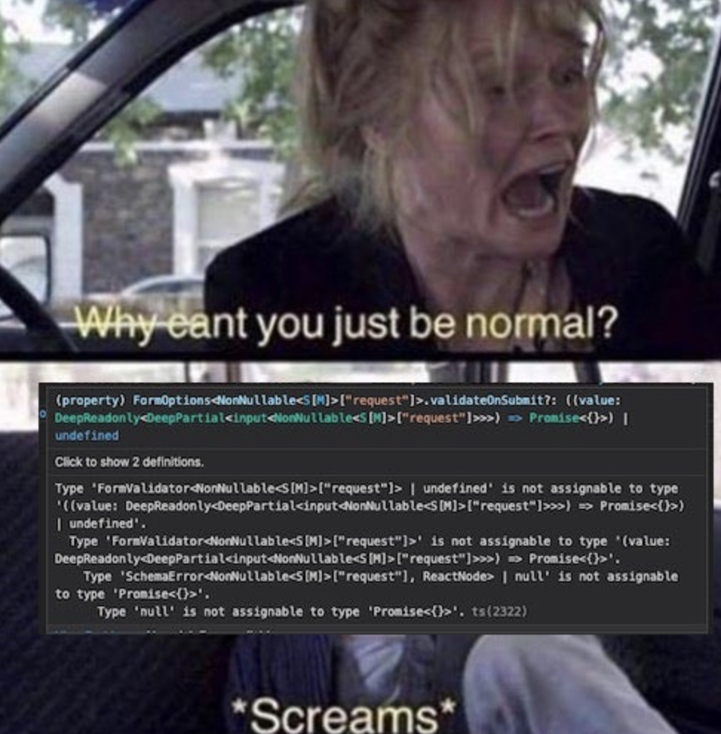
Complex scenarios
Complex types
Unclear errors

Slide 12
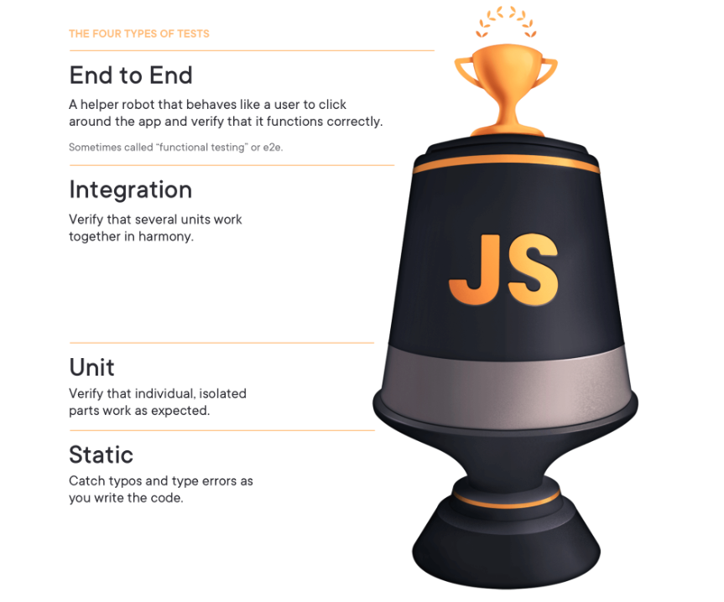
Why should we use Typescript?

Slide 13
Code maintainability
Structured
Self documentation
Interface first pattern thinking
Code quality

Slide 14
Productivity & Developer experience
IDE’s Support
Code naviagtion
Auto completion
Catch and fix issues quickly

Slide 15
Collaboration
Scalability
Understandable code
Decrease code review efforts
Onborading new developers

Slide 16
Eecosystem & community
Rich ecosystem and libraries
Angular by google

Slide 17
Compiler
Transpile code From TS to JS
Compiling under the same language abstraction

Slide 18
Using TSC
npm i typescript
Install globally
Tsconfig

Slide 19
Ts-node
Using ts-node to run Typescript
TS-node compiler options

Slide 20
Concurrently
Run our proccesses parallel when we have few projects Or few items to execute.
"start-dev": "concurrently -k -p \"[{name}]\" -n \"TSCompile,app\" -c \"red,green\" \"npm run compile\" \"npm start\" "

Slide 21

Type Annontation

Slide 22
Type inference
Auto detection
Typescript knows they type based on the value

Slide 23
Functions
Typed arguments
Function return type
Optional paramters
Default values

Slide 24

Never
Never will return anything
Throw an exception

Slide 25
Objects
Objects can be typed declared
Using property which not defined will throw error

Slide 26
Casting
Update TS explicitly with the requested type

